Slide 1
CSCI 561 Foundations of Artificial Intelligence Beyond Classical Search Chapter 4 [except 4.2])
Fall 2018
INSTRUCTOR: PROF. SHEILA TEJADA
cs561-l@mymaillists.usc.edu

Slide 2
Homework 1b
Posted on DEN course website.
One programming problem.
Start working on your homework early!
Due September 17th, 11:59PM Pacific Time.
Late homework will NOT be accepted.
Submission through Vocareum.com only.
Homework submitted through other channels will NOT be accepted.

Slide 3

Can submit homework multiple times before the deadline
3

Slide 4
Homework 1
Homework assignments are to be solved individually.
You are welcome to discuss class material in review groups, but do NOT discuss how to solve the homework assignments.
Will run checks for cheating.
Questions?
cs561-l@mymaillists.usc.edu
Office hours of TA:
http://www-scf.usc.edu/~csci561a/calendar.htm

Slide 5
Exercise: Search Algorithms
The following figure shows a portion of a partially expanded search tree. Each arc between nodes is labeled with the cost of the corresponding operator, and the leaves are labeled with the value of the heuristic function, h.
Which node (use the node’s letter) will be expanded next by each of the following search algorithms?
(a) Depth-first search
(b) Breadth-first search
(c) Uniform-cost search
(d) Greedy search
(e) A* search
A
h=20
3
5
B
19
h=14
C
D
6
h=18
h=15
4
5
5
E
F
G
H
h=10
h=12
h=8
h=10

Slide 6
Depth-first search
A
h=20
B
3
19
5
h=14
C
D
4
5
5
6
h=18
h=15
E
F
G
H
h=10
h=12
h=8
h=10
Node queue: initialization
# state depth path cost parent #
1 A 0 0 --

Slide 7
Depth-first search
A
h=20
B
3
19
5
h=14
C
D
4
5
5
6
h=18
h=15
E
F
G
H
h=10
h=12
h=8
h=10
Node queue: add successors to queue front; empty queue from top
# state depth path cost parent #
2 B 1 3 1
3 C 1 19 1
4 D 1 5 1
1 A 0 0 --

Slide 8
Depth-first search
A
h=20
B
3
19
5
h=14
C
D
4
5
5
6
h=18
h=15
E
F
G
H
h=10
h=12
h=8
h=10
Node queue: add successors to queue front; empty queue from top
# state depth path cost parent #
5 E 2 7 2
6 F 2 8 2
7 G 2 8 2
8 H 2 9 2
2 B 1 3 1
3 C 1 19 1
4 D 1 5 1
1 A 0 0 --

Slide 9
Depth-first search
A
h=20
B
3
19
5
h=14
C
D
4
5
5
6
h=18
h=15
E
F
G
H
h=10
h=12
h=8
h=10
Node queue: add successors to queue front; empty queue from top
# state depth path cost parent #
5 E 2 7 2
6 F 2 8 2
7 G 2 8 2
8 H 2 9 2
2 B 1 3 1
3 C 1 19 1
4 D 1 5 1
1 A 0 0 --

Slide 10
Exercise: Search Algorithms
The following figure shows a portion of a partially expanded search tree. Each arc between nodes is labeled with the cost of the corresponding operator, and the leaves are labeled with the value of the heuristic function, h.
Which node (use the node’s letter) will be expanded next by each of the following search algorithms?
(a) Depth-first search
(b) Breadth-first search
(c) Uniform-cost search
(d) Greedy search
(e) A* search
A
h=20
3
5
B
19
h=14
C
D
6
h=18
h=15
4
5
5
E
F
G
H
h=10
h=12
h=8
h=10

Slide 11
Breadth-first search
A
h=20
B
3
19
5
h=14
C
D
4
5
5
6
h=18
h=15
E
F
G
H
h=10
h=12
h=8
h=10
Node queue: initialization
# state depth path cost parent #
1 A 0 0 --
2 B 1 3 1
3 C 1 19 1
4 D 1 5 1
5 E 2 7 2
6 F 2 8 2
7 G 2 8 2
8 H 2 9 2

Slide 12
Breadth-first search
A
h=20
B
3
19
5
h=14
C
D
4
5
5
6
h=18
h=15
E
F
G
H
h=10
h=12
h=8
h=10
Node queue: add successors to queue end; empty queue from top
# state depth path cost parent #
1 A 0 0 --
2 B 1 3 1
3 C 1 19 1
4 D 1 5 1
5 E 2 7 2
6 F 2 8 2
7 G 2 8 2
8 H 2 9 2

Slide 13
Breadth-first search
A
h=20
B
3
19
5
h=14
C
D
4
5
5
6
h=18
h=15
E
F
G
H
h=10
h=12
h=8
h=10
Node queue: add successors to queue end; empty queue from top
# state depth path cost parent #
1 A 0 0 --
2 B 1 3 1
3 C 1 19 1
4 D 1 5 1
5 E 2 7 2
6 F 2 8 2
7 G 2 8 2
8 H 2 9 2

Slide 14
Breadth-first search
A
h=20
B
3
19
5
h=14
C
D
4
5
5
6
h=18
h=15
E
F
G
H
h=10
h=12
h=8
h=10
Node queue: add successors to queue end; empty queue from top
# state depth path cost parent #
1 A 0 0 --
2 B 1 3 1
3 C 1 19 1
4 D 1 5 1
5 E 2 7 2
6 F 2 8 2
7 G 2 8 2
8 H 2 9 2

Slide 15
Exercise: Search Algorithms
The following figure shows a portion of a partially expanded search tree. Each arc between nodes is labeled with the cost of the corresponding operator, and the leaves are labeled with the value of the heuristic function, h.
Which node (use the node’s letter) will be expanded next by each of the following search algorithms?
(a) Depth-first search
(b) Breadth-first search
(c) Uniform-cost search
(d) Greedy search
(e) A* search
A
h=20
3
5
B
19
h=14
C
D
6
h=18
h=15
4
5
5
E
F
G
H
h=10
h=12
h=8
h=10

Slide 16
Uniform-Cost search
A
h=20
B
3
19
5
h=14
C
D
4
5
5
6
h=18
h=15
E
F
G
H
h=10
h=12
h=8
h=10
Node queue: initialization add successors to queue so that entire queue is sorted by path cost so far; empty queue from top
# state depth path cost parent #
1 A 0 0 --
2 B 1 3 1
3 D 1 5 1
4 C 1 19 1

Slide 17
Uniform-Cost search
A
h=20
B
3
19
5
h=14
C
D
4
5
5
6
h=18
h=15
E
F
G
H
h=10
h=12
h=8
h=10
Node queue: add successors to queue so that entire queue is sorted by path cost so far; empty queue from top
# state depth path cost parent #
1 A 0 0 --
2 B 1 3 1
3 D 1 5 1
4 C 1 19 1
Sort key

Slide 18
Uniform-Cost search
A
h=20
B
3
19
5
h=14
C
D
4
5
5
6
h=18
h=15
E
F
G
H
h=10
h=12
h=8
h=10
Node queue: add successors to queue so that entire queue is sorted by path cost so far; empty queue from top
# state depth path cost parent #
1 A 0 0 --
2 B 1 3 1
3 D 1 5 1
5 E 2 7 2
6 F 2 8 2
7 G 2 8 2
8 H 2 9 2
4 C 1 19 1

Slide 19
Uniform-Cost search
A
h=20
B
3
19
5
h=14
C
D
4
5
5
6
h=18
h=15
E
F
G
H
h=10
h=12
h=8
h=10
Node queue: add successors to queue so that entire queue is sorted by path cost so far; empty queue from top
# state depth path cost parent #
1 A 0 0 --
2 B 1 3 1
3 D 1 5 1
5 E 2 7 2
6 F 2 8 2
7 G 2 8 2
8 H 2 9 2
4 C 1 19 1

Slide 20
Exercise: Search Algorithms
The following figure shows a portion of a partially expanded search tree. Each arc between nodes is labeled with the cost of the corresponding operator, and the leaves are labeled with the value of the heuristic function, h.
Which node (use the node’s letter) will be expanded next by each of the following search algorithms?
(a) Depth-first search
(b) Breadth-first search
(c) Uniform-cost search
(d) Greedy search
(e) A* search
A
h=20
3
5
B
19
h=14
C
D
6
h=18
h=15
4
5
5
E
F
G
H
h=10
h=12
h=8
h=10

Slide 21
Greedy search
A
h=20
B
3
19
5
h=14
C
D
4
5
5
6
h=18
h=15
E
F
G
H
h=10
h=12
h=8
h=10
Node queue: initialization
# state depth path cost total parent #
cost to goal cost
1 A 0 0 20 20 --
2 B 1 3 14 17 1
5 G 2 8 8 16 2
7 E 2 7 10 17 2
6 H 2 9 10 19 2
8 F 2 8 12 20 2
3 D 1 5 15 20 1
4 C 1 19 18 37 1

Slide 22
Greedy search
A
h=20
B
3
19
5
h=14
C
D
4
5
5
6
h=18
h=15
E
F
G
H
h=10
h=12
h=8
h=10
Node queue: Add successors to queue, sorted by cost to goal.
# state depth path cost total parent #
cost to goal cost
1 A 0 0 20 20 --
2 B 1 3 14 17 1
3 D 1 5 15 20 1
4 C 1 19 18 37 1
Sort key

Slide 23
Greedy search
A
h=20
B
3
19
5
h=14
C
D
4
5
5
6
h=18
h=15
E
F
G
H
h=10
h=12
h=8
h=10
Node queue: Add successors to queue, sorted by cost to goal.
# state depth path cost total parent #
cost to goal cost
1 A 0 0 20 20 --
2 B 1 3 14 17 1
5 G 2 8 8 16 2
7 E 2 7 10 17 2
6 H 2 9 10 19 2
8 F 2 8 12 20 2
3 D 1 5 15 20 1
4 C 1 19 18 37 1

Slide 24
Greedy search
A
h=20
B
3
19
5
h=14
C
D
4
5
5
6
h=18
h=15
E
F
G
H
h=10
h=12
h=8
h=10
Node queue: Add successors to queue, sorted by cost to goal.
# state depth path cost total parent #
cost to goal cost
1 A 0 0 20 20 --
2 B 1 3 14 17 1
5 G 2 8 8 16 2
7 E 2 7 10 17 2
6 H 2 9 10 19 2
8 F 2 8 12 20 2
3 D 1 5 15 20 1
4 C 1 19 18 37 1

Slide 25
Exercise: Search Algorithms
The following figure shows a portion of a partially expanded search tree. Each arc between nodes is labeled with the cost of the corresponding operator, and the leaves are labeled with the value of the heuristic function, h.
Which node (use the node’s letter) will be expanded next by each of the following search algorithms?
(a) Depth-first search
(b) Breadth-first search
(c) Uniform-cost search
(d) Greedy search
(e) A* search
A
h=20
3
5
B
19
h=14
C
D
6
h=18
h=15
4
5
5
E
F
G
H
h=10
h=12
h=8
h=10

Slide 26
A* search
A
h=20
B
3
19
5
h=14
C
D
4
5
5
6
h=18
h=15
E
F
G
H
h=10
h=12
h=8
h=10
Node queue: initialization to queue front, sorted by total cost.
# state depth path cost total parent #
cost to goal cost
1 A 0 0 20 20 --
2 B 1 3 14 17 1
5 G 2 8 8 16 2
6 E 2 7 10 17 2
7 H 2 9 10 19 2
3 D 1 5 15 20 1
8 F 2 8 12 20 2
4 C 1 19 18 37 1

Slide 27
A* search
A
h=20
B
3
19
5
h=14
C
D
4
5
5
6
h=18
h=15
E
F
G
H
h=10
h=12
h=8
h=10
Node queue: Add successors to queue front, sorted by total cost.
# state depth path cost total parent #
cost to goal cost
1 A 0 0 20 20 --
2 B 1 3 14 17 1
3 D 1 5 15 20 1
4 C 1 19 18 37 1
5 G 2 8 8 16 2
6 E 2 7 10 17 2
7 H 2 9 10 19 2
8 F 2 8 12 20 2
Sort key

Slide 28
A* search
A
h=20
B
3
19
5
h=14
C
D
4
5
5
6
h=18
h=15
E
F
G
H
h=10
h=12
h=8
h=10
Node queue: Add successors to queue front, sorted by total cost.
# state depth path cost total parent #
cost to goal cost
1 A 0 0 20 20 --
2 B 1 3 14 17 1
5 G 2 8 8 16 2
6 E 2 7 10 17 2
7 H 2 9 10 19 2
3 D 1 5 15 20 1
8 F 2 8 12 20 2
4 C 1 19 18 37 1

Slide 29
A* search
A
h=20
B
3
19
5
h=14
C
D
4
5
5
6
h=18
h=15
E
F
G
H
h=10
h=12
h=8
h=10
Node queue: Add successors to queue front, sorted by total cost.
# state depth path cost total parent #
cost to goal cost
1 A 0 0 20 20 --
2 B 1 3 14 17 1
5 G 2 8 8 16 2
6 E 2 7 10 17 2
7 H 2 9 10 19 2
3 D 1 5 15 20 1
8 F 2 8 12 20 2
4 C 1 19 18 37 1

Slide 30
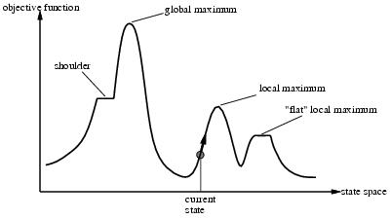
Hill Climbing
Move continuously in the direction of increasing value
Go to best successor of current state, based on evaluation
If more than one best successor, pick randomly among them
Terminate when reach a peak
May only find a local maximum
This form of hill climbing is also referred to as
Steepest-ascent hill climbing
Greedy local search
Continuous analogue is gradient ascent
Notes:
One dimensional space

Slide 31
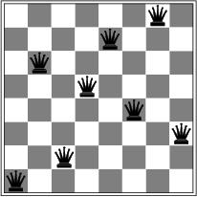
N-Queens problem
Works quickly
3-4 steps on average with state space of 8⁸ ≈ 17 million states
Plateaus can lead to wandering
An area of the state space where the evaluation function is flat
Ridges can make things very difficult
Sequence of local maxima difficult for greedy algorithms to navigate
Notes:
What is h?
Can’t reduce in one step because already one queen in each row

Slide 32
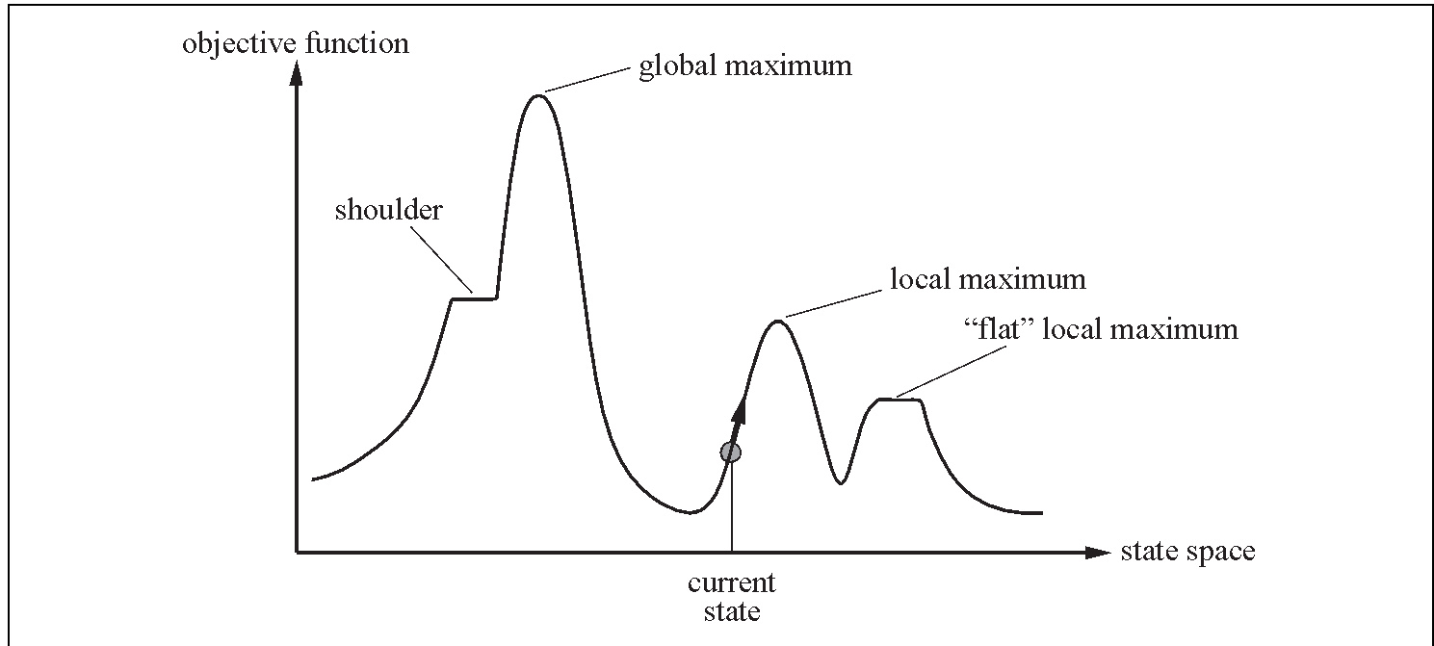
Hill Climbing
What are the advantages and disadvantages of classical hill-climbing?
Can you think of real-world examples where hill-climbing would be particularly good?
What about bad?
Notes:
The success of hill climbing depends very much on the shape of the state-space land- scape: if there are few local maxima and plateaux, random-restart hill climbing will find a good solution very quickly. On the other hand, many real problems have a landscape that looks more like a widely scattered family of balding porcupines on a flat floor, with miniature porcupines living on the tip of each porcupine needle, ad infinitum. NP-hard problems typically have an exponential number of local maxima to get stuck on. Despite this, a reasonably good local maximum can often be found after a small number of restarts.

Slide 33
Local beam search
1. Start with k randomly generated nodes.
2. Generate all successors of each of the k.
3. Keep the best k out of the them.
4. Repeat till goal or stop condition reached
K=2
K=2
Notes:
What is local beam search?
It begins with k randomly generated states. At each step, all the successors of all k states are generated. If any one is a goal, the algorithm halts. Otherwise, it selects the k best successors from the complete list and repeats.
At first sight, a local beam search with k states might seem to be nothing more than running k random restarts in parallel instead of in sequence. In fact, the two algorithms are quite different. In a random-restart search, each search process runs independently of the others. In a local beam search, useful information is passed among the parallel search threads. In effect, the states that generate the best successors say to the others, “Come over here, the grass is greener!” The algorithm quickly abandons unfruitful searches and moves its resources to where the most progress is being made.
In its simplest form, local beam search can suffer from a lack of diversity among the k states—they can quickly become concentrated in a small region of the state space, making the search little more than an expensive version of hill climbing. A variant called stochastic beam search, analogous to stochastic hill climbing, helps alleviate this problem. Instead of choosing the best k from the the pool of candidate successors, stochastic beam search chooses k successors at random, with the probability of choosing a given successor being an increasing function of its value. Stochastic beam search bears some resemblance to the process of natural selection, whereby the “successors” (offspring) of a “state” (organism) populate the next generation according to its “value” (fitness).

Slide 34
Simulated Annealing
Escape local maxima by allowing “bad” moves
The worse the move the less likely it is to be chosen
Gradually decrease likelihood of bad moves over time
Ball analogy (assumes going for minimum)
Ball rolls to lower regions
Shaking (temperature/vibrations) can move it to higher
If T decreases slowly enough, optimal state is reached

Slide 35
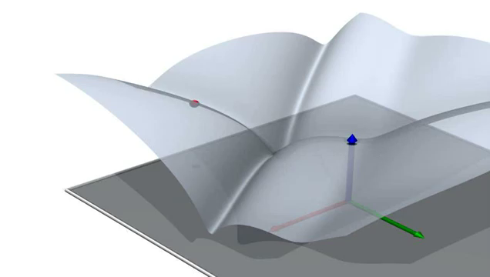

Slide 36
Simulated Annealing Algorithm Based on Maximization
function SIMULATED-ANNEALING(problem, schedule) return a solution state
input: problem, a problem
schedule, a mapping from time to temperature
current ← MAKE-NODE(problem.INITIAL-STATE)
for t ← 1 to ∞ do
T ← schedule(t)
if T = 0 then return current
next ← a randomly selected successor of current
∆E ← next.VALUE – current.VALUE
if ∆E > 0 then current ← next
else current ← next, only with probability e^{∆E/T}
Variant of stochastic hill climbing where can also go downhill
Notes:
This variant freezes all moves when T=0 rather than just freezing out uphill moves

Slide 37
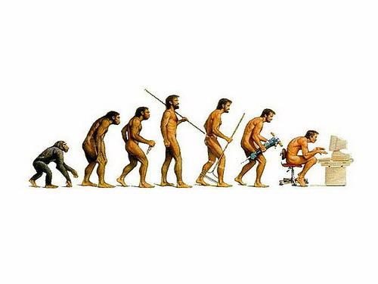
Genetic Algorithms

Slide 38


Example: Traveling Sales Person
Classic Example: You have N cities, find the shortest route such that your salesperson will visit each city once and return.
This problem is known to be NP-Hard
As a new city is added to the problem, computation time in the classic solution increases exponentially O(2^{n}) … (as far as we know)
Dallas
Is this the shortest path???
Austin
Houston
Mos Eisley
San Antonio
A Texas Sales Person

Slide 39
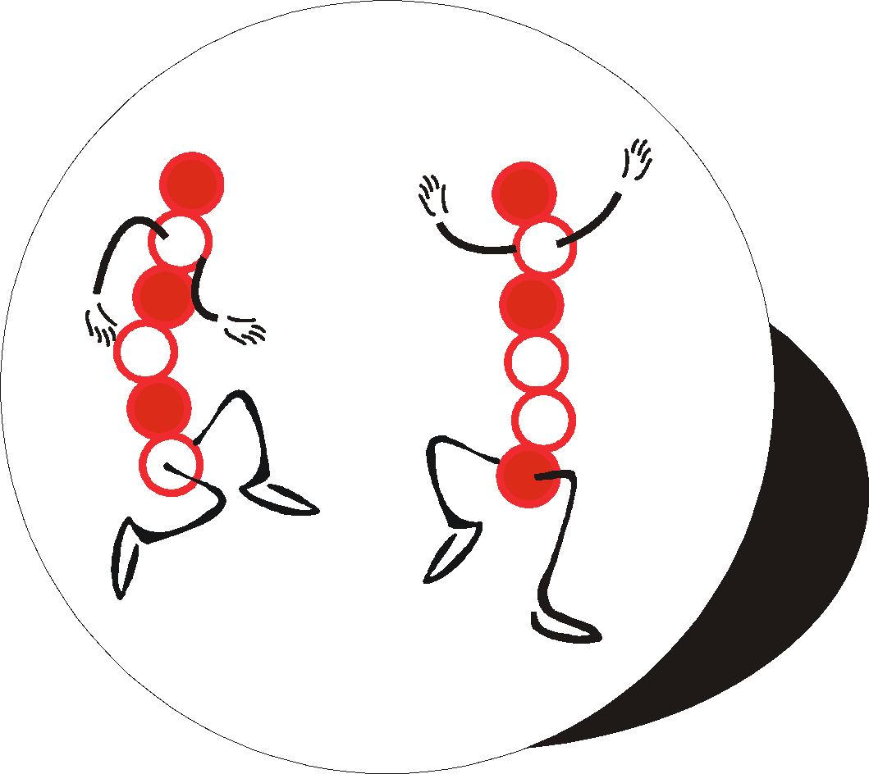
Represent problem like a DNA sequence
Each DNA sequence is a
possible solution to the
problem.
DNA - Salesperson A
Dallas
Houston
Mos Eisely
San Antonio
Austin
San Antonio
Dallas
Mos Eisely
Houston
Austin
DNA - Salesperson B
The order of the cities in
the genes is the order of
the cities the TSP will take.
Notes:
One the fitness has been assigned, pairs of chromosomes representing heat exchanger designs can be chosen for mating.
The higher the fitness, the greater the probability of the design being selected. Consequently, some of the weaker population members do not mate at all, whilst superior ones are chosen many times.
It is even statistically possible for a member to be chosen to mate with itself. This has no advantage, as the offspring will be identical to the parent.

Slide 40
Crossover
Not all crossed pairs are viable. We can only visit a city once.
Different GA problems may have different bounds.
Parents
Children
Dallas
Houston
Austin
San Antonio
Mos Eisely
San Antonio
Dallas
Mos Eisely
Houston
Austin
San Antonio
Dallas
Austin
San Antonio
Mos Eisely
Dallas
Houston
Mos Eisely
Houston
Austin
Not Viable!!

Slide 41

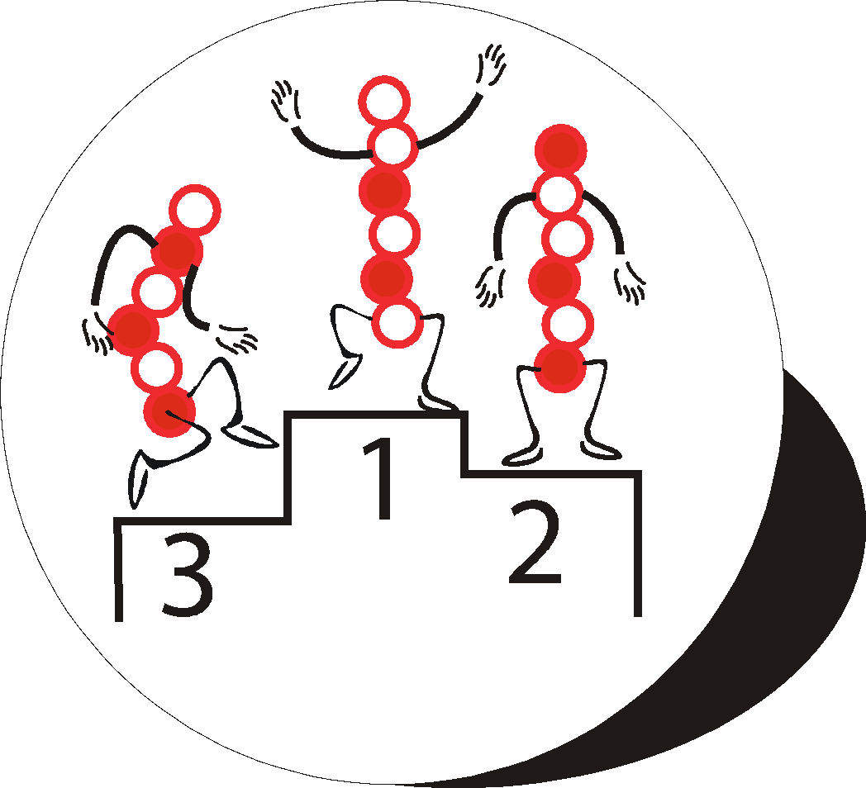

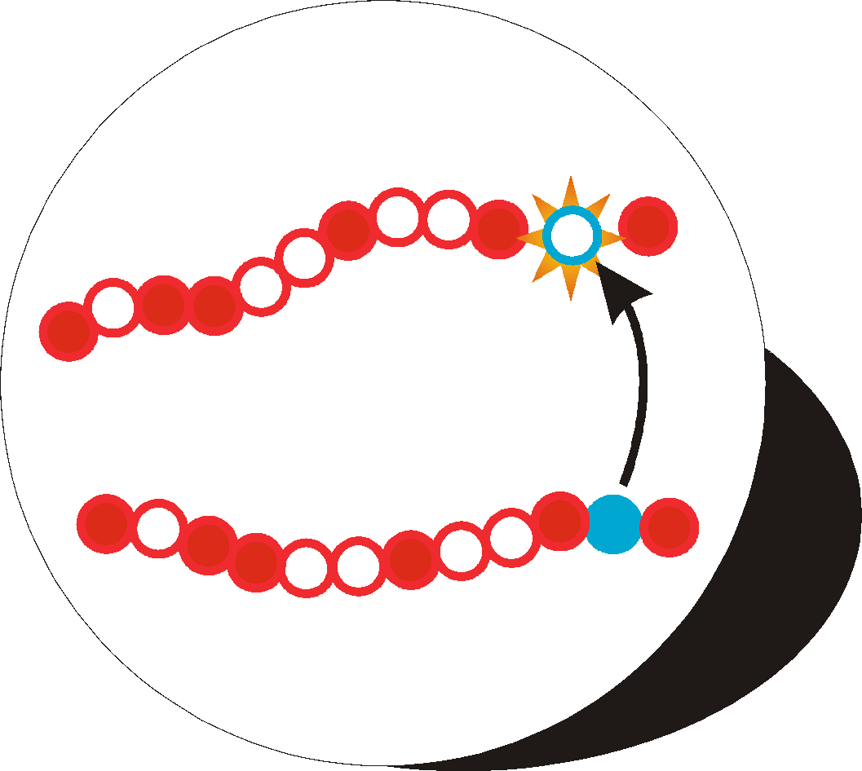
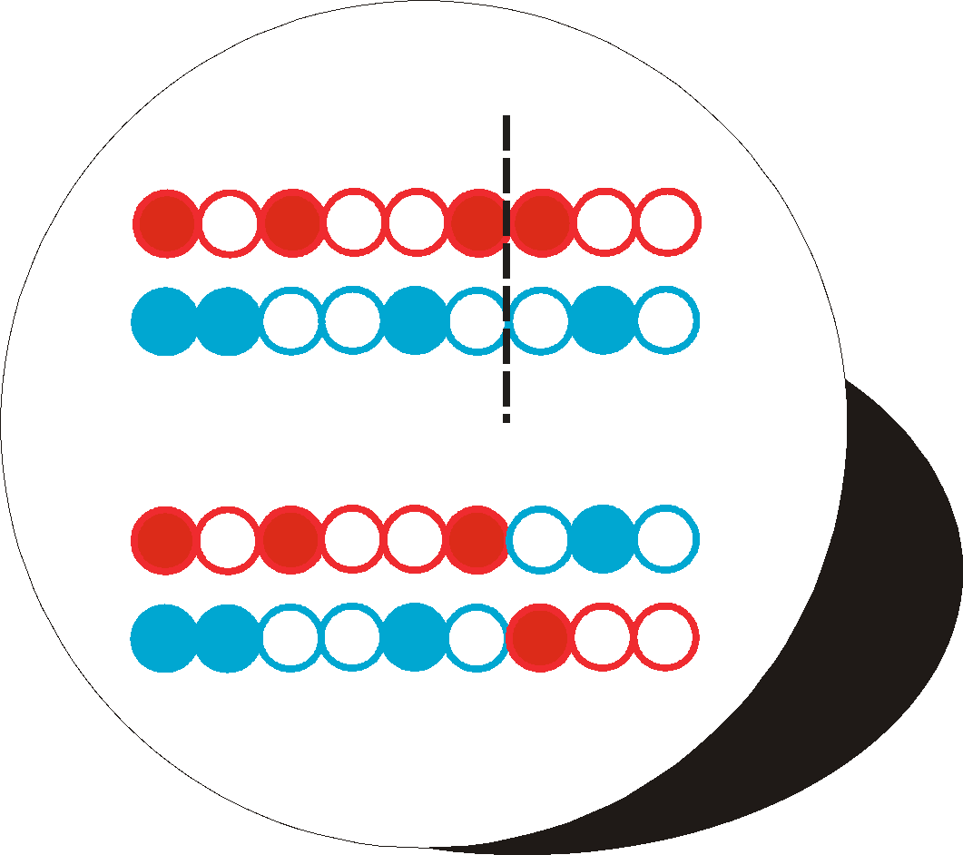
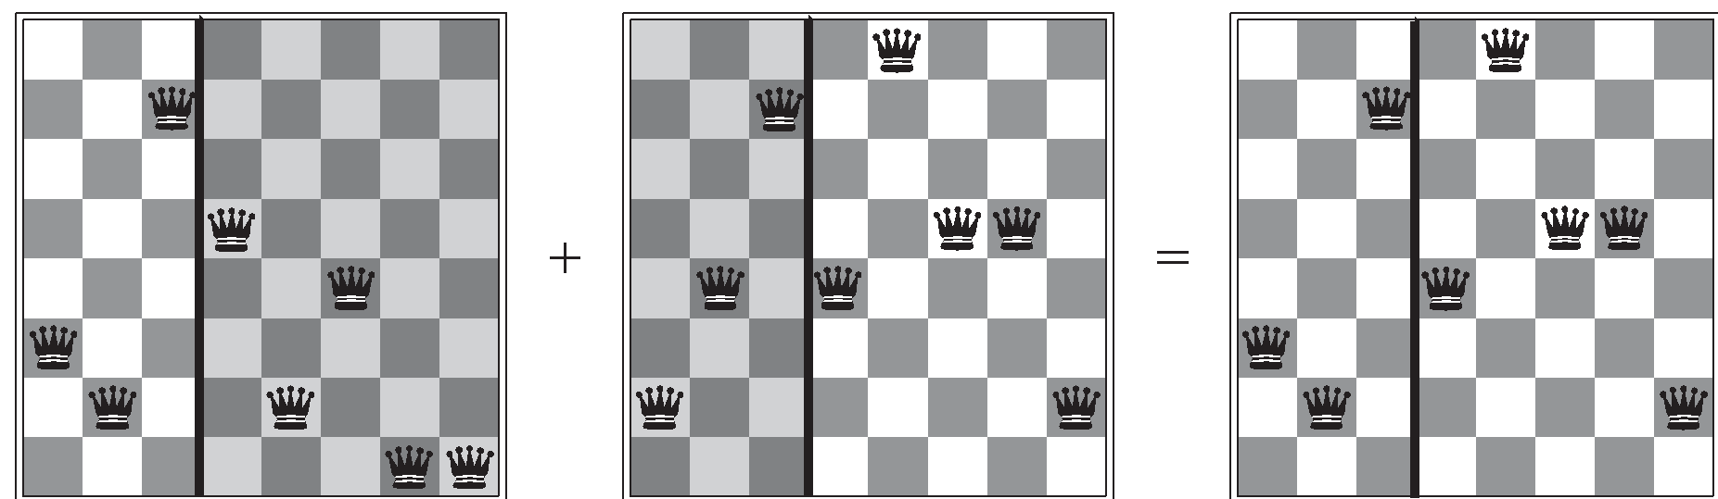
The Genetic Algorithm Cycle
New Population
Fitness
Selection
Mutation
Crossover
Notes:
Summary of the previous steps to the model.
Populations are continuously produced, going round the outer loop of this diagram, until the desired amount of optimisation has been achieved.

Slide 42
Genetic algorithm
“A genetic algorithm is a variant of stochastic beam search in which successor states are generated by combining two parent states rather than by modifying a single state.”
What might be possible advantages of this approach over stochastic beam search?
For what kinds of problems is a genetic algorithm approach appropriate? When not? Why?
K=2

Slide 43
Exercise 4.1
Give the name of the algorithm that results from each of the following special cases:
Local beam search with k = 1.
Local beam search with one initial state and no limit on the number of states retained.
Simulated annealing with T = 0 at all times (and omitting the termination test).
Simulated annealing with T = ∞ at all times.
Genetic algorithm with population size N = 1.
Hill Climbing
BFS
Hill Climbing
Random
Walk
Random Walk
Notes:
Local beam search with k = 1 is hill-climbing search.
Local beam search with one initial state and no limit on the number of states retained, resembles breadth-first search in that it adds one complete layer of nodes before adding the next layer. Starting from one state, the algorithm would be essentially identical to breadth-first search except that each layer is generated all at once.
Simulated annealing with T = 0 at all times: ignoring the fact that the termination step would be triggered immediately, the search would be identical to first-choice hill climb- ing because every downward successor would be rejected with probability 1. (Exercise may be modified in future printings.)
Simulated annealing with T = ∞ at all times is a random-walk search: it always accepts a new state.
Genetic algorithm with population size N = 1: if the population size is 1, then the two selected parents will be the same individual; crossover yields an exact copy of the individual; then there is a small chance of mutation. Thus, the algorithm executes a random walk in the space of individuals.

Slide 44
Next Time
Adversarial Search (Games) (Chapter 5)
Constraint Satisfaction Problems (Chapter 6)
Practice Exercises:
Chapter 4: # 4.1
Chapter 6: # 6.1, 6.5

